Slide 1
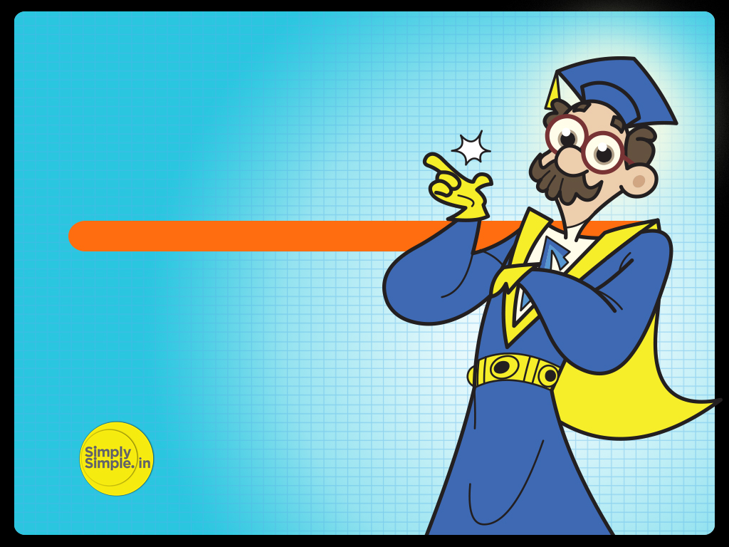

FED TAPERING
GREECE STORY

Slide 2

Understanding the Greece story

Slide 3
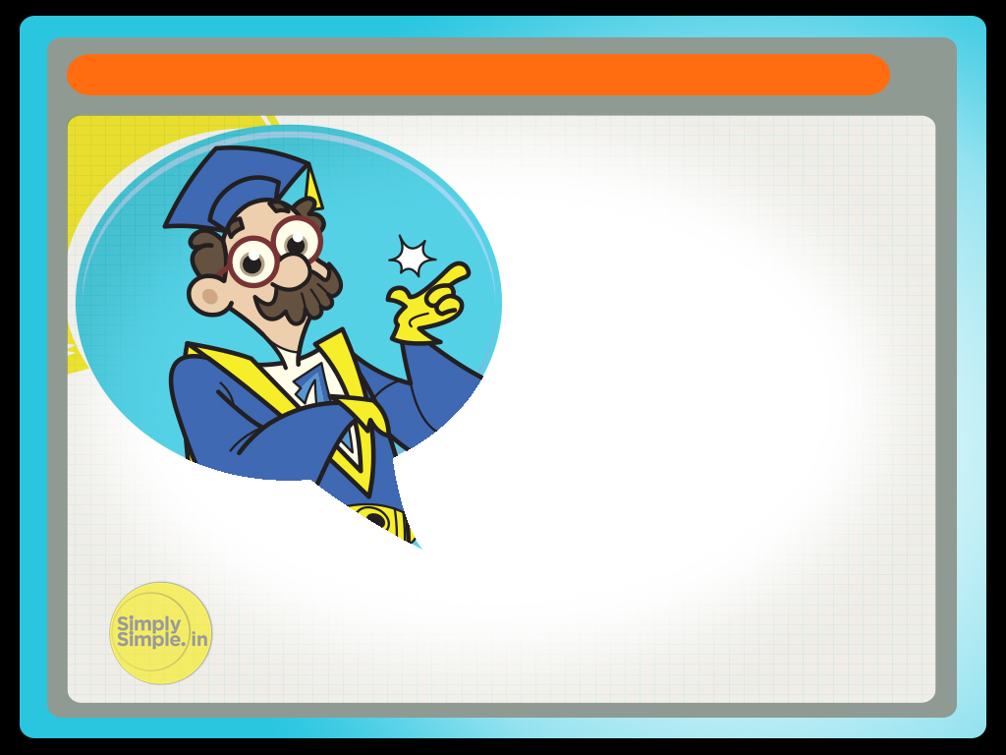
GREECE STORY
Greece has been in the news because of its economic problems. What are these problems? Let’s understand

Slide 4
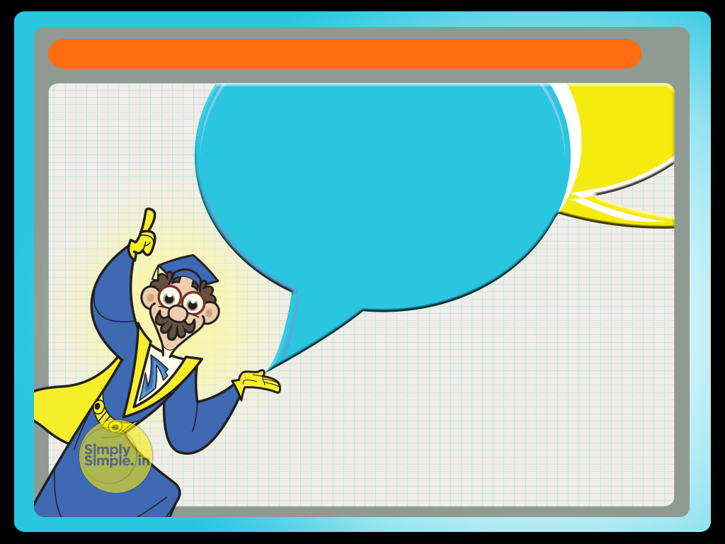
GREECE STORY
To understand this let’s imagine Greece, Portugal, Spain, Italy, Ireland, Germany, France, are not countries but brothers

Slide 5

GREECE STORY
Interestingly, the brothers share a common pool account named “EURO”.
In short the brothers would contribute into and spend from the common account.

Slide 6
GREECE STORY
Amongst the brothers, Greece happened to be a spendthrift person. In order to maintain his lifestyle Greece had been borrowing money from his friends.

Slide 7
GREECE STORY
While Greece had been spending recklessly his earnings did not keep pace with the same.

Slide 8
GREECE STORY
Hence he was on a perpetual debt. To pay this debt he had been taking additional debt from his friends.

Slide 9
GREECE STORY
Each time he took a new debt he agreed to a higher interest rate. Friends would lend him money because they knew he was sharing the common pool account with his brothers.

Slide 10
GREECE STORY
Hence he was on a perpetual debt.

Slide 11
GREECE STORY
This poor track record of Greece worried his brothers because they shared the common family pool account with him.
Because of Greece’s spending ways, the credibility of the family pool account suffered.

Slide 12
GREECE STORY
In order to protect the family name the brothers had no choice but to bail out Greece time and again.
The brothers were unhappy with this situation.
They felt that it is unfair for them to bail out their spendthrift brother Greece time and again.

Slide 13
GREECE STORY
They threatened to take strict action against Greece unless he changed his spendthrift attitude.
They ordered Greece to change his lifestyle and lead a simpler life thereby increasing his “savings” to repay his debt.

Slide 14
GREECE STORY
This is the Greece story. The family pool account is nothing but the common currency EURO.

Slide 15
GREECE STORY
The brothers are the countries of the European Union who are afraid that because of Greece the value of their currency will depreciate.
The frugal lifestyle being imposed are the economic reforms for austerity that was passed by the Greece parliament.

Slide 16
GREECE STORY
Hope you now understand the “Greece” story

Slide 17

Please give us your feedback at
professor@tataamc.com

Slide 18
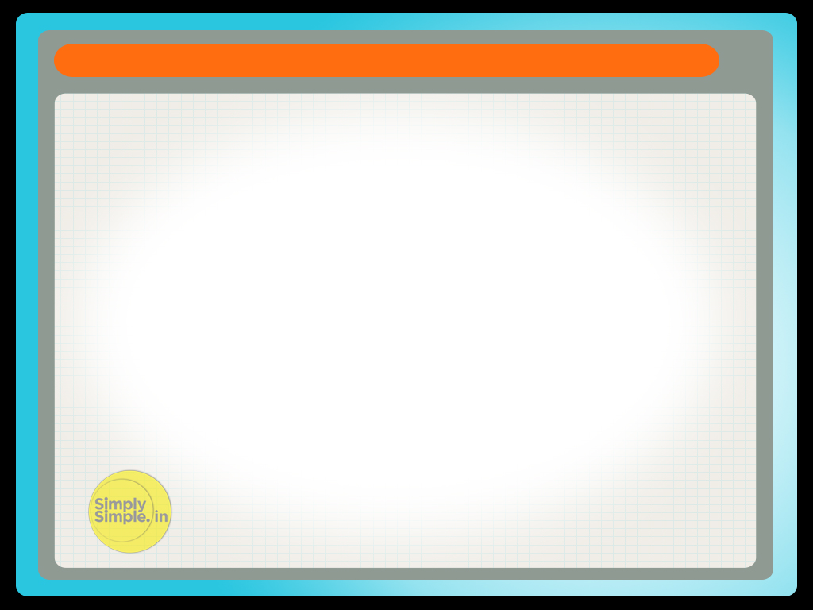
DISCLAIMER
The views expressed in this lesson are for information purposes only and do not construe to be any investment, legal or taxation advice. The lesson is a conceptual representation and may not include several nuances that are associated and vital. The purpose of this lesson is to clarify the basics of the concept so that readers at large can relate and thereby take more interest in the product / concept. In a nutshell, Professor Simply Simple lessons should be seen from the perspective of it being a primer on financial concepts. The contents are topical in nature and held true at the time of creation of the lesson. This is not indicative of future market trends, nor is Tata Asset Management Ltd. attempting to predict the same. Reprinting any part of this material will be at your own risk. Tata Asset Management Ltd. will not be liable for the consequences of such action.
Mutual Fund investments are subject to market risks, read all scheme related documents carefully.

